Slide 1




Workflow Insight Panel (Project Management)
Team (D)
DEPI_ONL2_DAT1_G7
Presented to Eng: Abdallah Mostafa
25\4\2025
1

Slide 2
Project Idea
Problem
Mismatch between forecasted, actual, and budgeted hours across many projects.
High percentage of over-budget and delayed projects.
Disproportionate number of tickets raised in Russia, indicating regional performance issues.
Projects in “Under Development” phase show inconsistent effort and delivery timelines.
9.2%
70.2%
18.6%
152 days
67.8%
Open Tickets
Closed Tickets
Discarded Tickets
Average ticket duration
Russia Tickets
25\4\2025
2

Slide 3
The Proposed solution
Use historical data and predictive modeling to improve forecasting accuracy.
Implement real-time dashboards to monitor hours, budgets, and ticket flow.
Redistribute resources based on team efficiency and workload. Segment ticket data to identify root causes and apply targeted actions.
Set up monthly reviews to track performance and apply early interventions
25\4\2025
3

Slide 4
Unique value proposition
Focuses on analyzing project performance by identifying gaps between forecasted vs. actual hours and budgets.
Highlights regional inefficiencies through real-time dashboards and data segmentation.
Provides data-driven solutions such as better forecasting, workload redistribution, and issue prioritization to improve efficiency and reduce delays.
25\4\2025
4

Slide 5

TimeLine & Milestones
Week 1: Data cleaning & Processing
By using Python and SQL
Building Data Model
Data preprocessing notebook.
Week 2: Analysis Questions Phase
Set of analysis questions that can be answered via the dataset.
Challenges and Solutions
Tips to overcome these challenges.
Week 4: Visualization Dashboard
A Tableau dashboard that
visualizes the answers to all answered questions.
Week 3: Forecasting Questions
Visualization plots answering forecasting questions.
25\4\2025
5

Slide 6
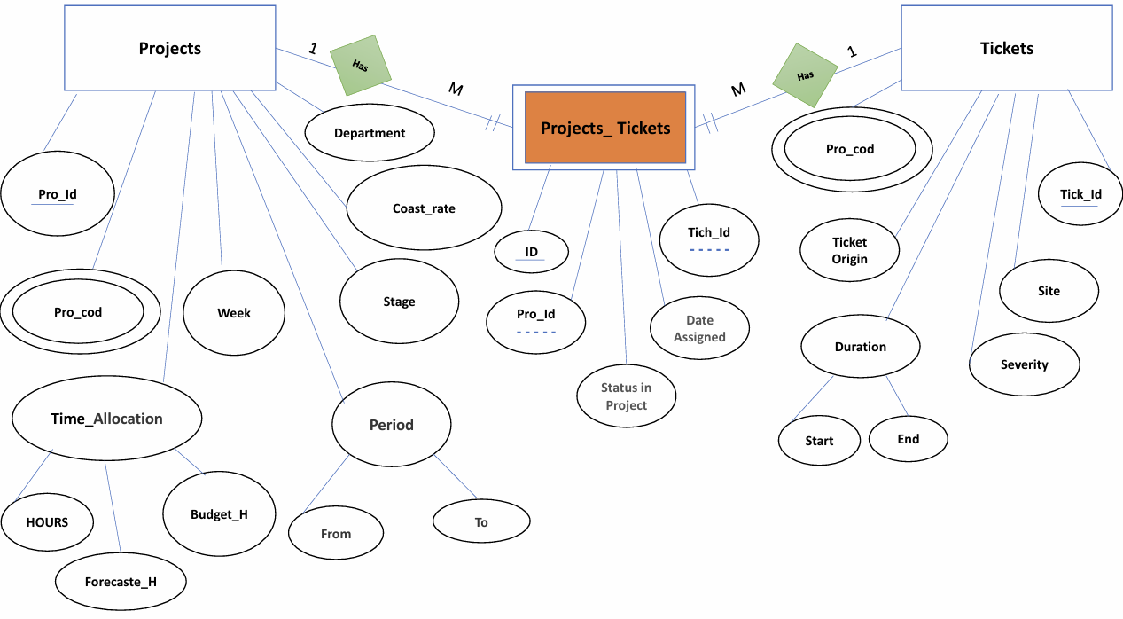
Project ER Diagram
25\4\2025
6

Slide 7
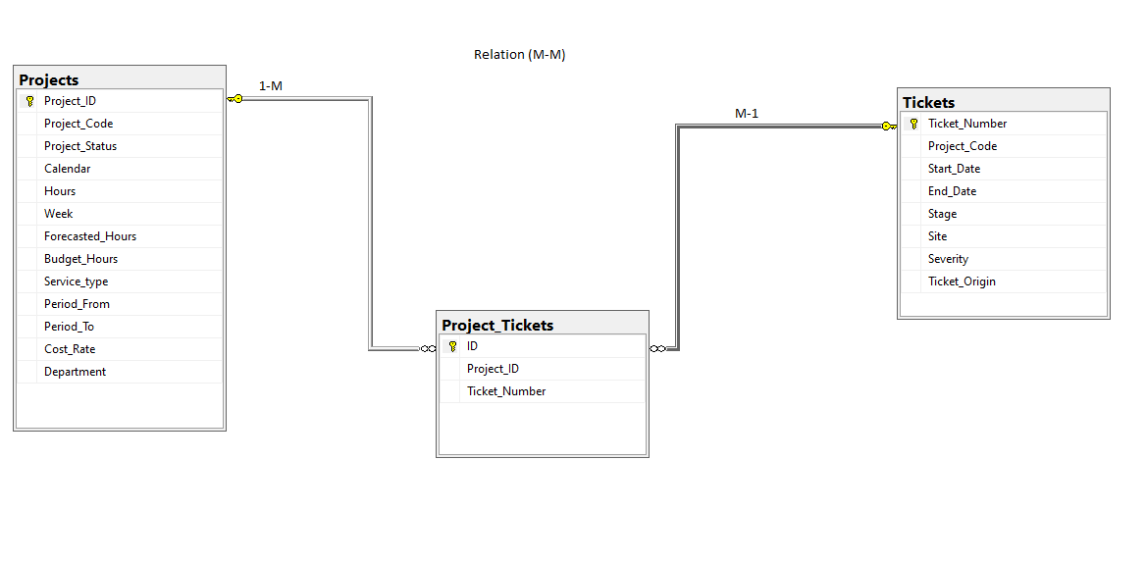
Database schema
25\4\2025
7

Slide 8
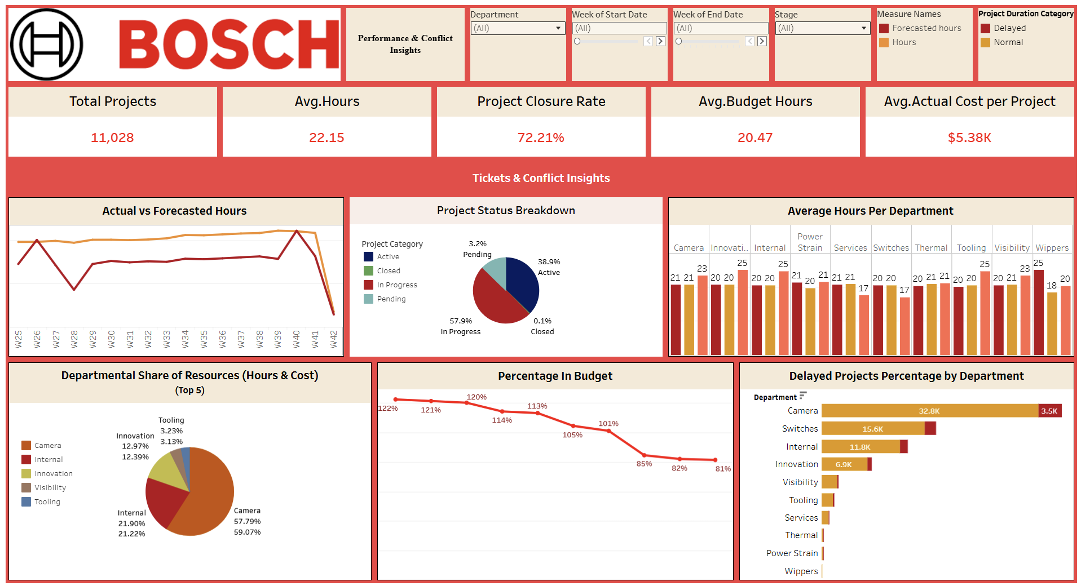
Workflow insight panel
25\4\2025
8

Slide 9
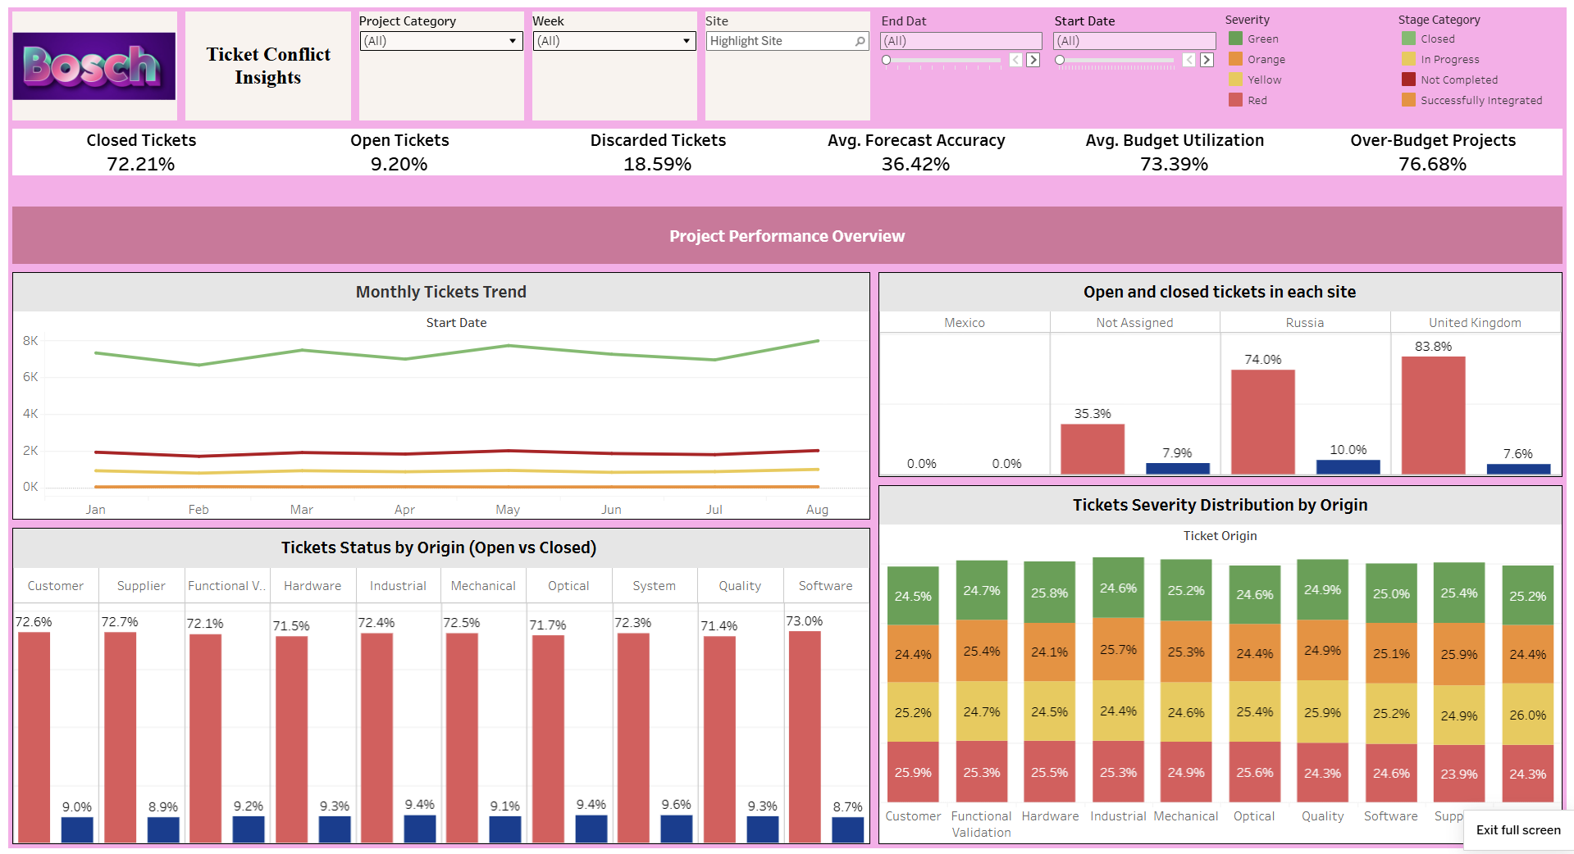
Workflow insight panel
25\4\2025
9

Slide 10
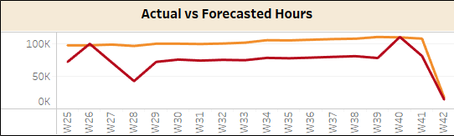
Actual VS Forecasted hours
Insights:
Actual working hours often don’t match the forecasted hours.
Many projects are going over budget.
About 10.26% of projects have more than 20 tickets, which is considered high.
Most tickets are coming from Russia, which could show a problem there
Action plan:
Review how we forecast hours to find and fix mistakes.
Look closely at which teams or projects have big differences in their hours or budgets.
Group the tickets from Russia by type and urgency to better understand the issues.
Focus more attention on projects with too many tickets or that are over budget.
Actual hours
Forecasted hours
25\4\2025
10

Slide 11
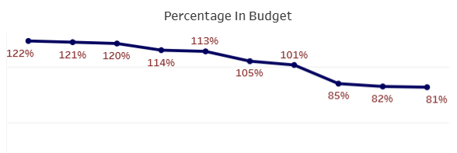
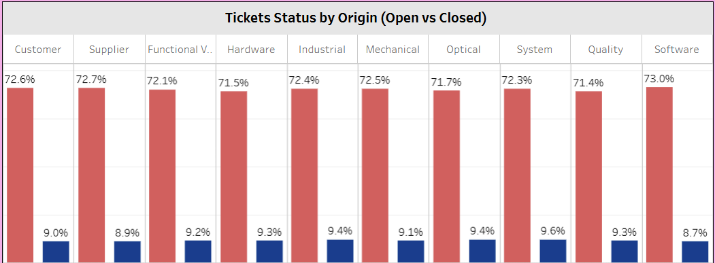
Key Observations
Budget management per department :
The Tooling department exceeded its budget at 122%, while the Wipers department dropped to just 81%, showing a steady budget decline.
This trend suggests issues in spending control or inaccurate planning across departments.
Recommended Action:
Review project timelines, financial records, and resource plans to identify causes and prevent future overruns.
Ticket Distribution Imbalance:
Across all categories, closed tickets consistently outnumber open ones, reflecting solid resolution efforts.
However, tickets from the System origin have the highest percentage of open tickets, suggesting a need for deeper analysis.
Recommended Action:
The tickets from origin (system) has the highest open tickets percentage, it needs targeted interventions.
25\4\2025
11

Slide 12













Programming languages & frameworks
Programming languages:
Frameworks & Tools:
Supporting technologies:
25\4\2025
12

Slide 13
Project Team Members
Ismail Sobhy
AL Shaimaa Mohamed
Eman Yousef
Project coordinator Forecasting dashboard
Final dashboard
Database & BI Developer
Final dashboard
Forecasting Questions
Python developer
Presentation Creator
Reporting Analyst
Khaled Hussien
Mohamed Sherif
Amr Mamdouh
Python developer
Data processing Analyst
Insights Analyst
Data Exploration
Forecasting Questions
Data cleaning
25\4\2025
13

Slide 14

Thank you!
25\4\2025
14

